Slide 1

AB Testing
Hypothesis Testing
- Mukesh Sajjan

Slide 2
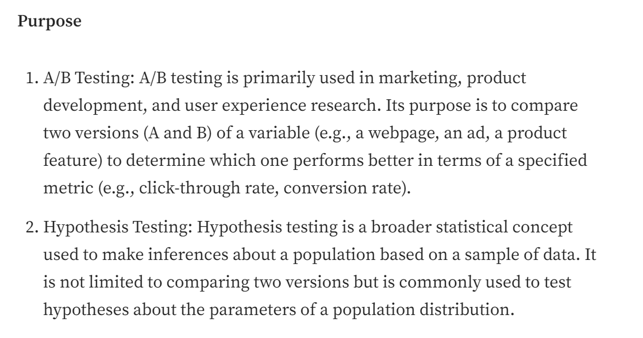
A/B Testing Vs Hypothesis Testing

Slide 3
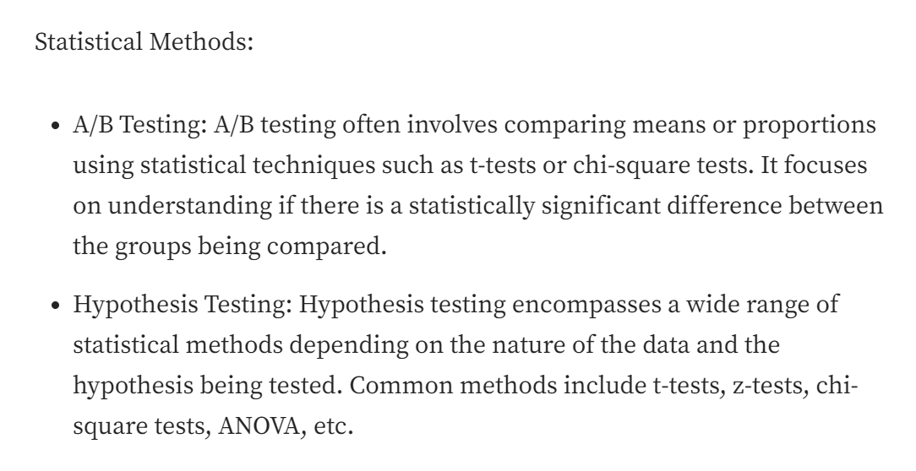
A/B Testing Vs Hypothesis Testing

Slide 4
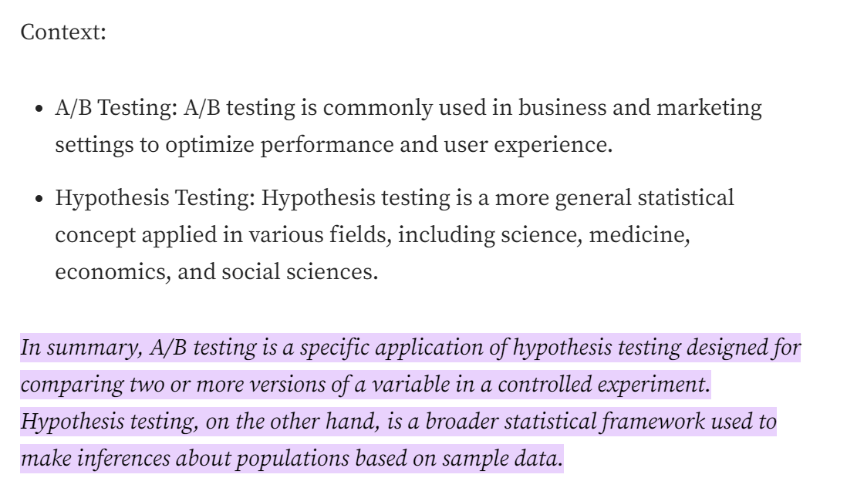
A/B Testing Vs Hypothesis Testing

Slide 5
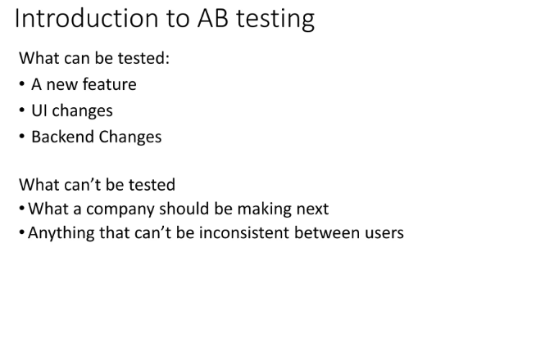
AB Testing

Slide 6
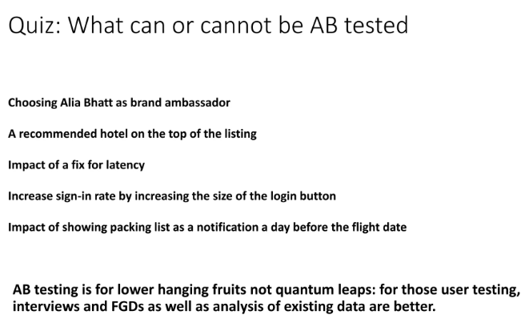
AB Testing

Slide 7
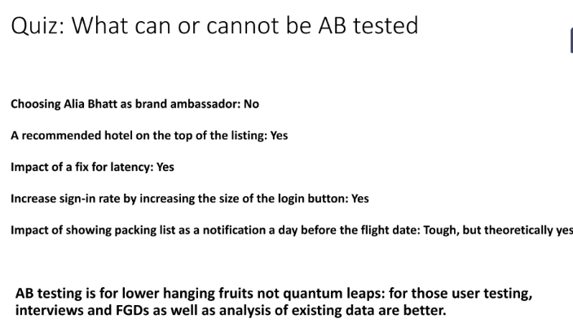
AB Testing

Slide 8
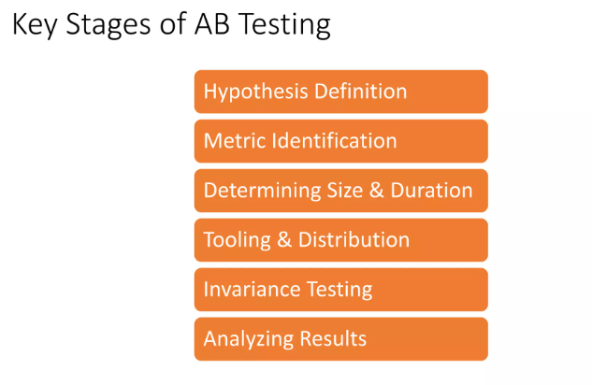
Stages

Slide 9
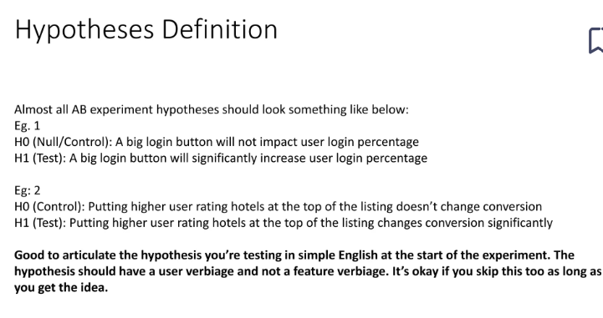
Types of Statistics

Slide 10
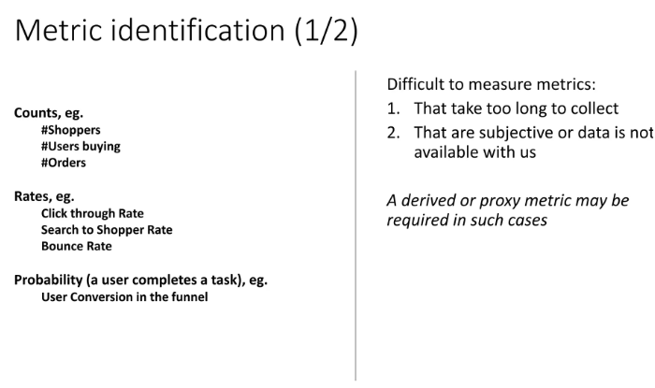
Types of Statistics

Slide 11
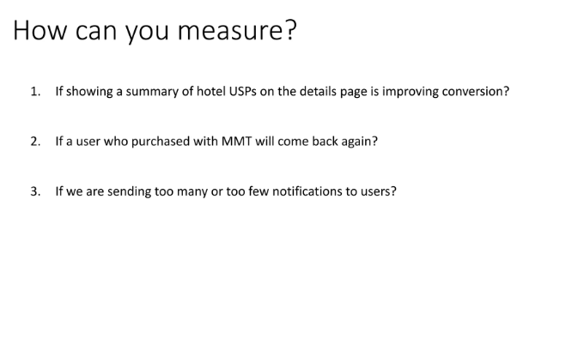
Types of Statistics

Slide 12
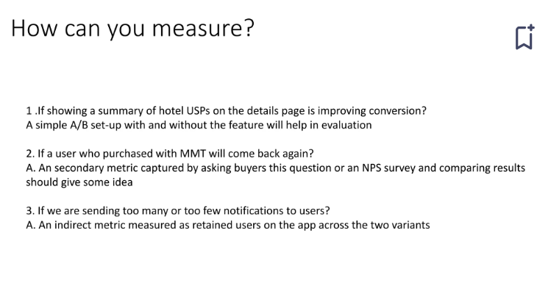
Types of Statistics

Slide 13
Hypothesis Testing
  A common technique in inferential statistics is hypothesis testing, which involves making a statement about a population parameter and assessing the evidence against that statement based on sample data. The results of hypothesis tests help researchers make decisions and draw conclusions.
With hypothesis testing, there are two hypotheses that is formed generally which are mainly the Null hypothesis and the Alternative hypothesis. Where the Null hypothesis contradicts the assumption made in the alternative hypothesis. We set a significance threshold and test for 2 possible scenarios which are to either
Reject the null hypothesis
ii. Fail to reject the null hypothesis

Slide 14
Types of Tests
Z-test: If population means and standard deviations are known. Z-statistic is commonly used.
t-test: If population standard deviations are unknown. and sample size is small than t-test statistic is more appropriate.
Chi-square test: Chi-square test is used for categorical data or for testing independence in contingency tables
F-test: F-test is often used in analysis of variance (ANOVA) to compare variances or test the equality of means across multiple groups.

Slide 15
Type 1 and Type 2 Error
Type 1 error: When we reject the null Hypothesis, although that hypothesis was true. Type 1 error is denoted by alpha.
Type 2 error: When we accept the null Hypothesis, but it is false. Type 2 error is denoted by beta.

Slide 16
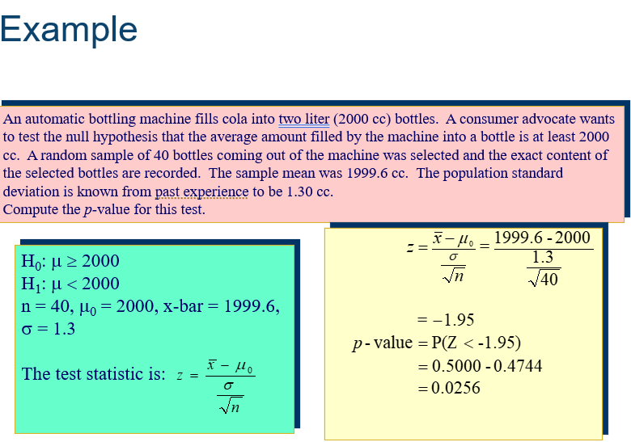
Case Study

